Slide 1
Automated Patent Summarization System - Condensed lengthy patents into easy-to-read summaries
Project Guide: Team Members
N. Durga Prasanna Mam 1. K.Sai Kushal (22B85A1207)
2. P.Adarsh Phanindra (21B81A12B0)
3. T.Prabhu (22B85A1212)
4. K.Sai Krishna (22B85A1209)

Slide 2
Contents
Abstract 11) Output Screen
Introduction 12) Conclusion
Existing System 13) Future Enhancements
Proposed System
Functional Requirements
Non-Functional Requirements
Tools and Technologies
Design Phase
Data Flow Diagram
Modules Overview

Slide 3
Abstract
To address the challenge of efficiently understanding patent documents, this project developed an AI-powered Patent Summarization System. This system employs the fine tuned GPT-4 model, informed by a dataset of patents and their summaries, to generate concise, context-aware summaries, extracting essential details like invention purpose, novelty, and legal claims. It significantly enhancing accessibility and reducing patent analysis time. Performance is evaluated using ROUGE and BERTScore to assess the quality of the generated summaries.

Slide 4
Introduction
The complexity and length of patent documents create a significant hurdle for efficient information retrieval and understanding. Traditional manual review methods are often slow and resource-intensive. To overcome this, this project presents an AI-powered Patent Summarization System that leverages the capabilities of the GPT-4 model to generate concise, context-aware summaries, thereby streamlining the comprehension of patents for professionals in various fields.

Slide 5
Evaluation Metrics
1. ROUGE (Recall-Oriented Understudy for Gisting Evaluation):
ROUGE checks how many words or phrases from the original summary are also present in the AI-generated summary.
It helps measure how much important information is covered.
2. BERTScore (Bidirectional Encoder Representations from Transformers):
It uses contextual embeddings from the BERT model to compare the semantic similarity between the generated summary and the reference text.
It goes beyond surface-level word matching and measures meaning-level alignment.

Slide 6
Existing System
Manual Review: Labor-intensive and error-prone, especially for complex patents.
Keyword-Based Search Engines: Cannot understand the contextual meaning of patent claims or innovations.
Template-Based Generators: Provide static outputs without dynamic adaptation.
Basic NLP Systems: Lack depth in legal/technical context handling, leading to vague summaries.

Slide 7
Proposed System
The proposed system uses a fine-tuned GPT-4o-mini model to automate the generation of concise summaries for complex patent documents
It takes patent text as input through a Gradio interface and processes it via a Flask backend connected to the fined-tuned GPT-4o-mini model.
The system's fine-tuned GPT-4o-mini model excels at producing better patent summaries with greater brevity than the original ChatGPT model.

Slide 8
Functional Requirements
Data Handling: The system efficiently loads, processes, and formats patent datasets for summarization.
User Interface: The system enables users to input patent descriptions and receive summaries via a web interface.
Summarization: The system generates concise, context-aware summaries of patent descriptions using a fine-tuned GPT model.
Visualization: The system visually compares the length of original patent texts with their generated summaries.

Slide 9
Non-Functional Requirements
High Performance – Ensures quick processing of large patent documents.
Scalability – Handles increasing data loads efficiently.
User-Friendly Interface – Provides easy navigation and real-time summarization.
Easy Maintenance – Modular code structure for future updates and enhancements.

Slide 10
Tools and Technologies
1. Hardware Requirements:
Processor :Intel i5/i7 CPU
Ram :8GB RAM
Storage :100GB Storage
2. Software Requirements:
Programming Language: Python
AI Model: OpenAI GPT-4o mini fined tuned
Frontend Framework: Gradio (for UI)
Backend Framework: Flask
Libraries: Pandas, Matplotlib, Seaborn

Slide 11
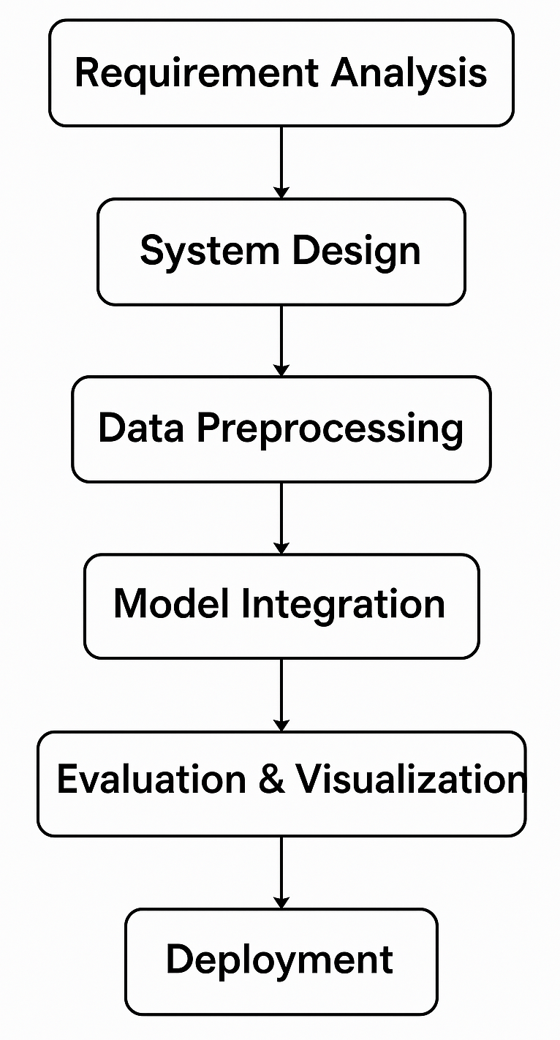
Design Phase
Requirement Analysis: Identified the need for an AI tool to simplify and summarize lengthy patent documents.
System Design: Planned a modular architecture using Flask for backend and Gradio for frontend interaction.
Data Preprocessing: Cleaned and formatted patent datasets using Pandas for consistent model input.
Model Integration: Connected the application to fined tuned GPT-4o mini model for generating accurate, context-aware summaries.
Implementation: Developed the user interface and backend logic to process input and display summaries.
Evaluation & Visualization: Used ROUGE, BERT Score, and visual tools to assess and compare summarization quality.
Deployment: Launched the application with a public link using Gradio for real-time access.

Slide 12
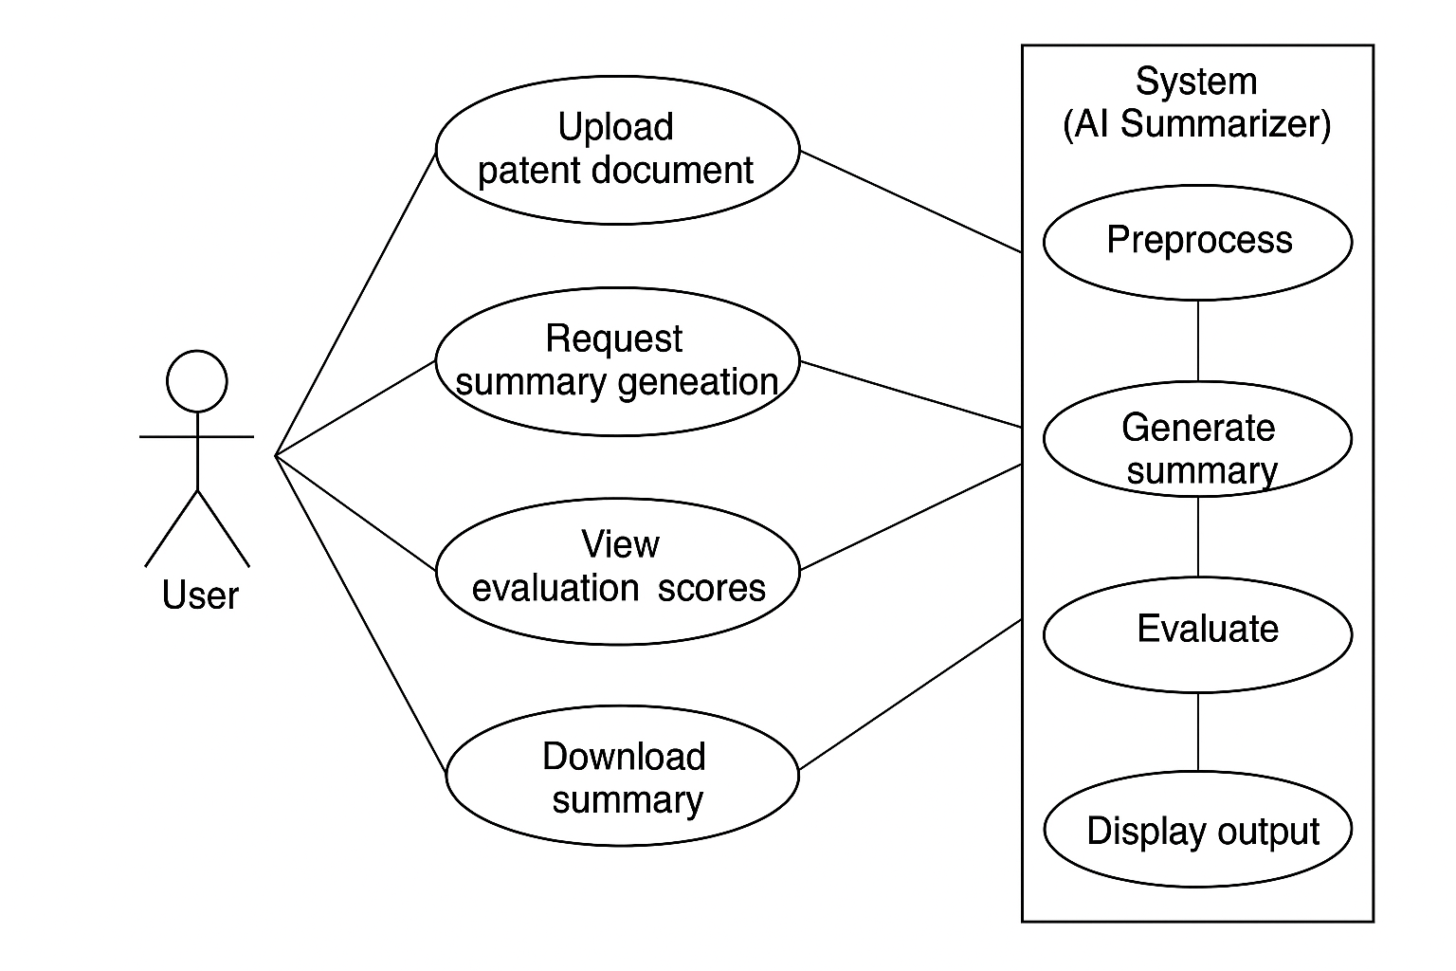
Use-Case Diagram

Slide 13
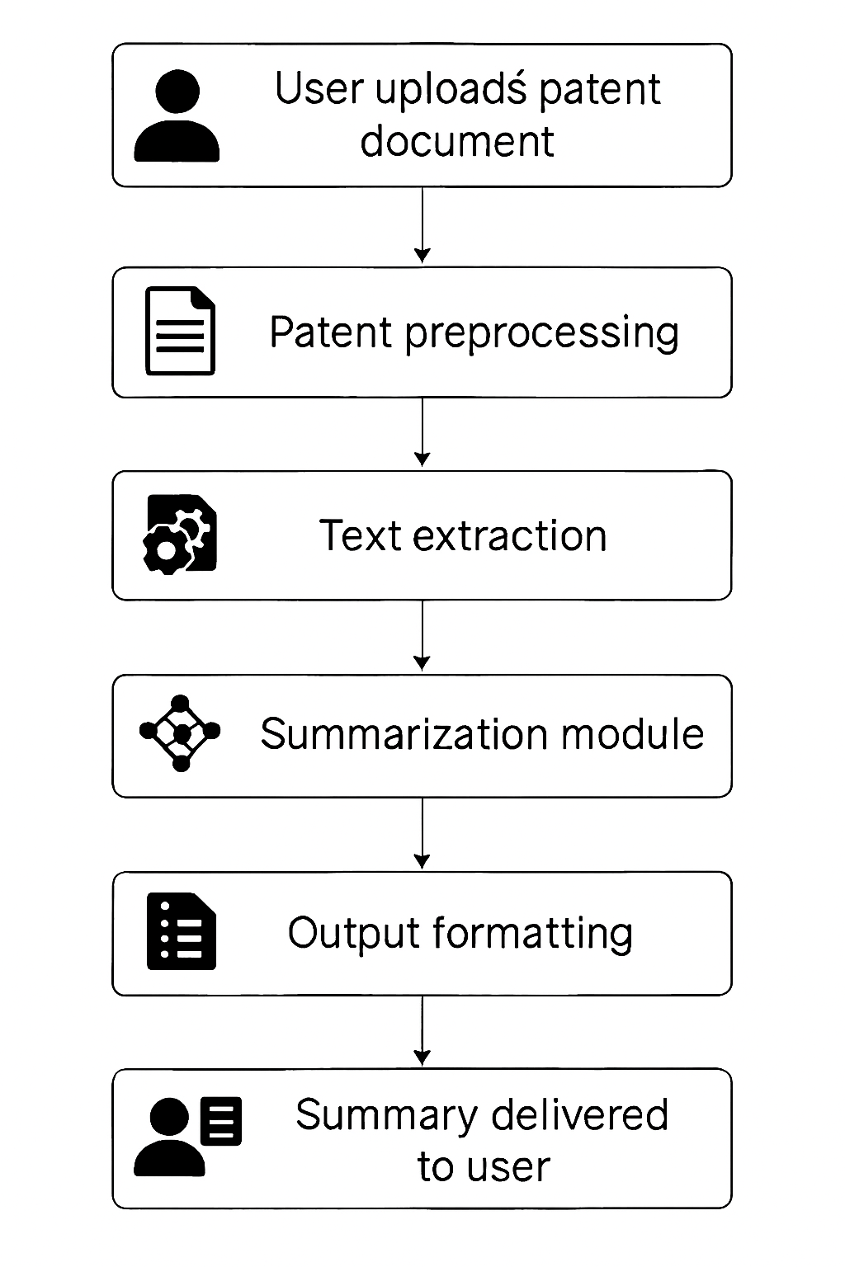
Data Flow
User Uploads Patent Document : The user provides a patent file to the system.
Patent Preprocessing : The system cleans and processes the text (e.g., OCR for images, remove noise, tokenize).
Text Extraction : Extracts the core content from the patent, such as claims, abstract, and detailed descriptions.
Summarization Module : Uses AI/ML models to generate a short, readable summary.
Output Formatting : The summary is formatted neatly (paragraphs) for easy reading.
Summary Delivered to User : Final summarized version is shown to the user.

Slide 14
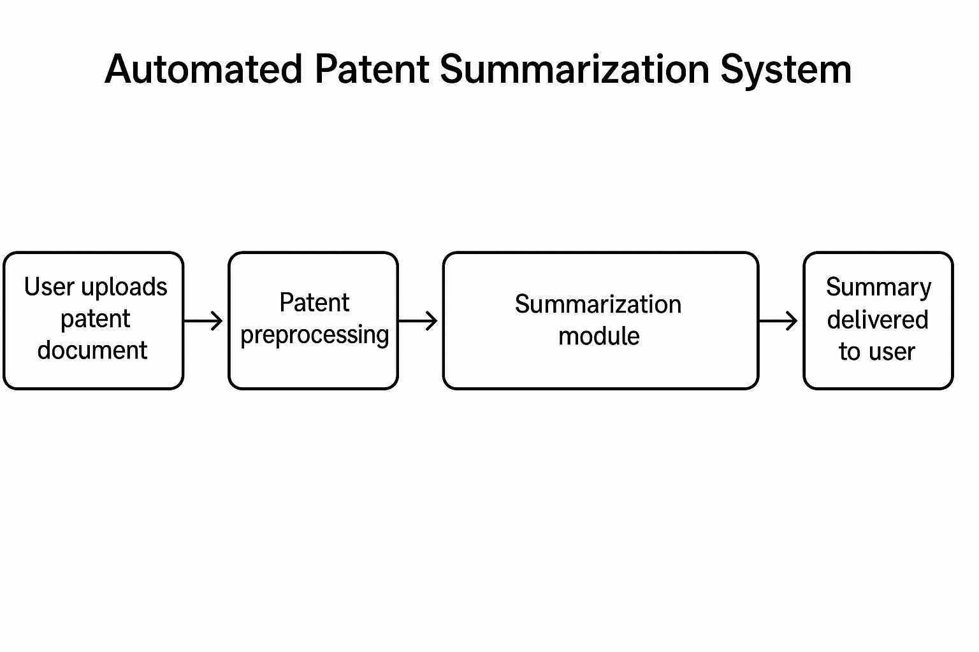
Modules Overview
Data Collection: Acquires and prepares patent datasets for training and evaluation.
AI Model Integration: Implements patent summarization using a fine-tuned GPT model.
User Interface: Provides an interactive Gradio UI for user input and output of summaries.
Performance Tracking:Evaluates the summarization model’s performance and system efficiency.

Slide 15
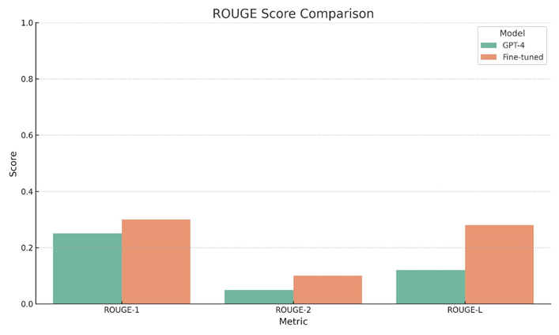
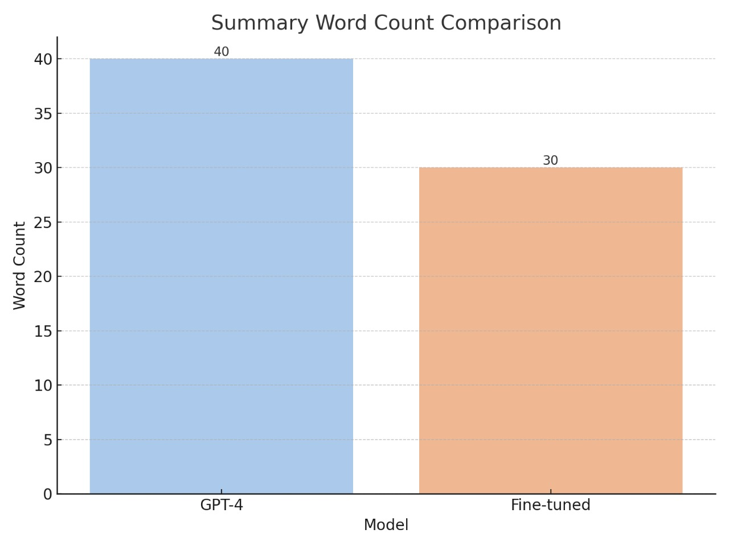
Performance Analysis
The fine-tuned model makes shorter summaries (30 words) than GPT-4 (40 words).
The fine-tuned model has better ROUGE-1 and ROUGE-L scores than GPT-4.
The fine-tuned model beats GPT-4 in the ROUGE-2 score.

Slide 16
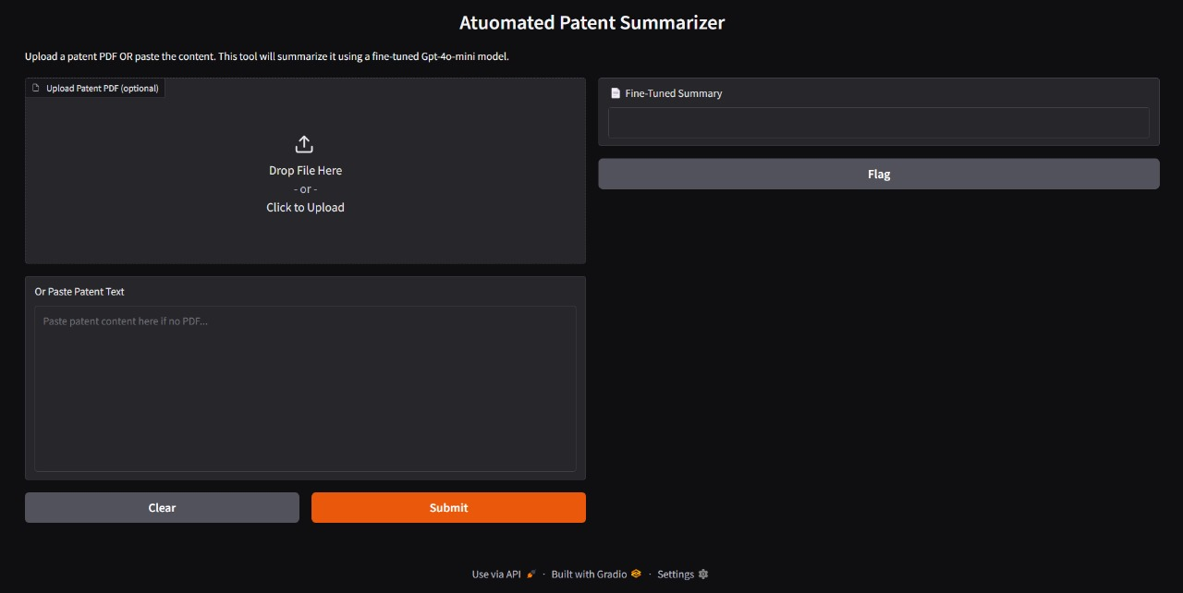
Output Screen

Slide 17
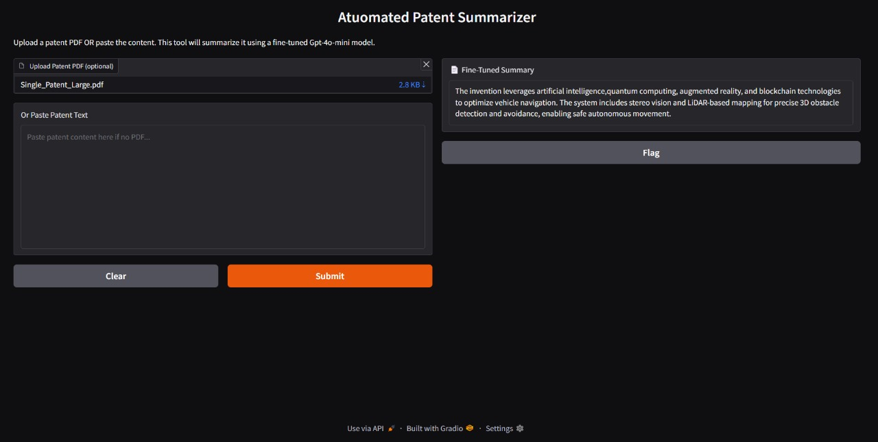
Output Screen-Input 1 & Output 1

Slide 18
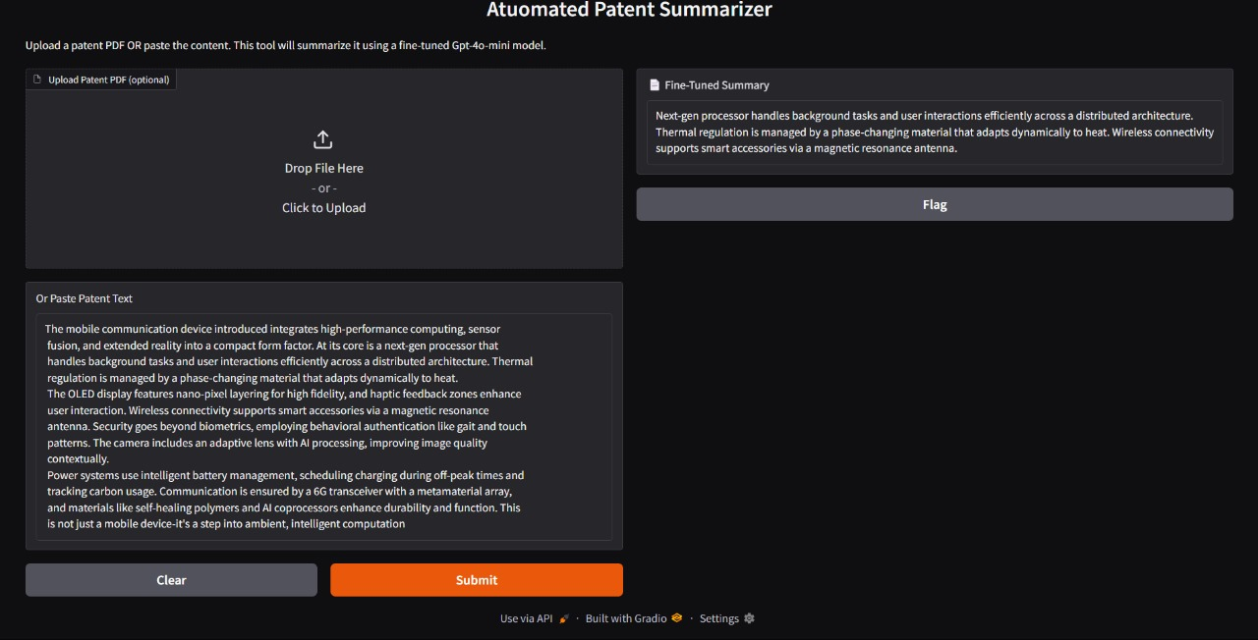
Output Screen-Input 2 & Output 2

Slide 19
Conclusion
The Automated Patent Summarization System efficiently condenses lengthy and complex patent documents into concise, easy-to-read summaries using a fine-tuned GPT-4 model. By integrating Natural Language Processing, Machine Learning, and a user-friendly web interface, the system simplifies patent analysis and improves accessibility for legal professionals, researchers, and innovators. Overall, the system reduces manual effort, enhances comprehension, and accelerates decision-making in the patent review process.

Slide 20
Future Enhancements
Audio/Video Summarization: Expand support to voice and multimedia patent documents
Voice-Based Query Input: Enable speech-to-text interaction
Mobile App Integration: Extend accessibility across platforms
Advanced Legal Analysis: Detect infringement risks and legal overlaps
Custom Summary Styles: Provide technical, legal, and layman-level summaries
Enterprise Dashboard: Real-time analytics for bulk patent processing

Slide 21
THANK YOU
.

